Slide 1
Linear regression: implementations

Slide 2
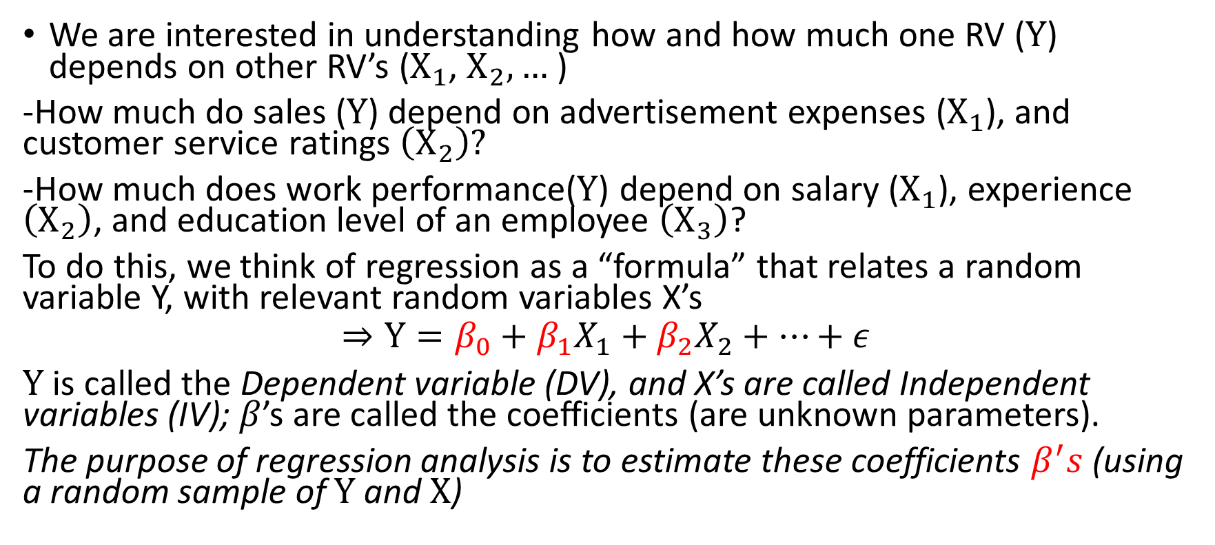
Purpose of regression analysis
We are interested in understanding how and how much one RV ($Y$) depends on other RV’s ($X_{1}$, $X_{2},…$ )
-How much do sales ($Y$) depend on advertisement expenses ($X_{1}$), and customer service ratings $\left(X_{2}\right)?$
-How much does work performance($Y$) depend on salary ($X_{1}$), experience $\left(X_{2}\right)$, and education level of an employee $\left(X_{3}\right)$?
To do this, we think of regression as a “formula” that relates a random variable Y, with relevant random variables X’s
$$⇒Y=β_{0}+β_{1}X_{1}+β_{2}X_{2}+…+ε$$
$Y$ is called the Dependent variable (DV), and X’s are called Independent variables (IV); $β$’s are called the coefficients (are unknown parameters).
The purpose of regression analysis is to estimate these coefficients $β^{′}s$ (using a random sample of $Y$ and $X$)

Slide 3
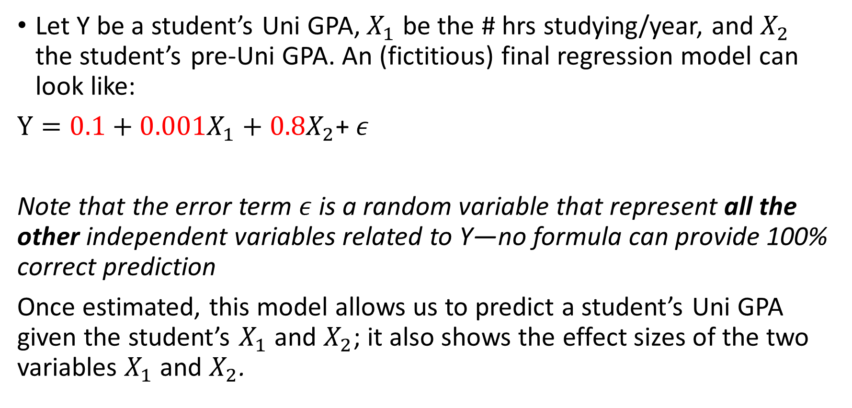
Linear regression model: An example
Let Y be a student’s Uni GPA, $X_{1}$ be the # hrs studying/year, and $X_{2}$ the student’s pre-Uni GPA. An (fictitious) final regression model can look like:
$Y=0.1+0.001X_{1}+0.8X_{2}$+ $ε$
Note that the error term $ε$is a random variable that represent all the other independent variables related to Y—no formula can provide 100% correct prediction
Once estimated, this model allows us to predict a student’s Uni GPA given the student’s $X_{1}$ and $X_{2}$; it also shows the effect sizes of the two variables $X_{1}$ and $X_{2}$.

Slide 4
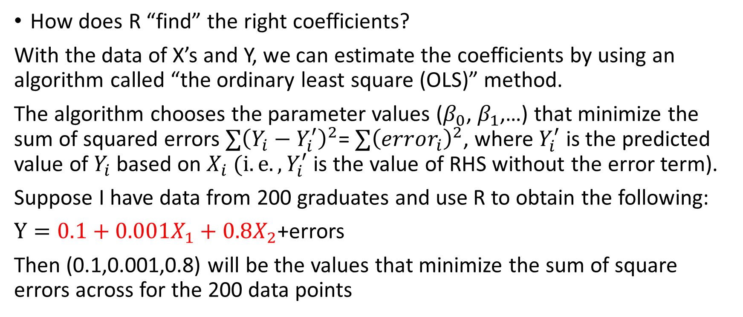
Linear Regression: Estimating the coefficients
How does R “find” the right coefficients?
With the data of X’s and Y, we can estimate the coefficients by using an algorithm called “the ordinary least square (OLS)” method.
The algorithm chooses the parameter values ($β_{0}$, $β_{1}$,…) that minimize the sum of squared errors ${∑\left(Y_{i}−Y_{i}^{′}\right)}^{2}$= ${∑\left(error_{i}\right)}^{2}$, where $Y_{i}^{′}$ is the predicted value of $Y_{i}$based on $X_{i} (i.e., Y_{i}^{′}$ is the value of RHS without the error term).
Suppose I have data from 200 graduates and use R to obtain the following:
$Y=0.1+0.001X_{1}+0.8X_{2}$+errors
Then (0.1,0.001,0.8) will be the values that minimize the sum of square errors across for the 200 data points

Slide 5


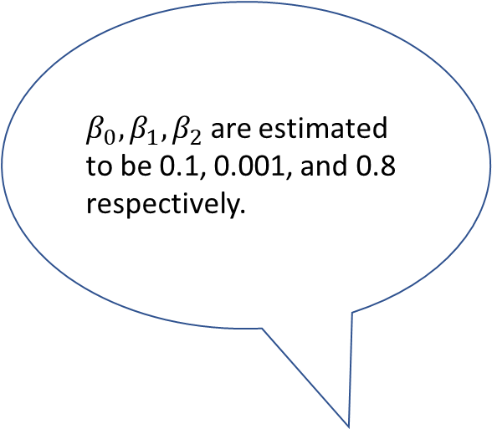
$β_{0}, β_{1},β_{2}$ are estimated to be 0.1, 0.001, and 0.8 respectively.
Random sample (X’s and Y)
I also estimated the sample standard deviations of these three coefficient, which you may use for statistical inference (i.e., CI or HT)
Computer algorithm (OLS)

Slide 6
Use X to predict Y in a regression
Rolls | Dice #1 (X) | Dice #2 (Z) | Y (#1+#2)
1 | 6 | 3 | 9
2 | 3 | 4 | 7
3 | 4 | 6 | 10
4 | 6 | 2 | 8
5 | 6 | 4 | 10
6 | 5 | 3 | 8
7 | 1 | 5 | 6
8 | 3 | 5 | 8
9 | 6 | 5 | 11
10 | 3 | 5 | 8
11 | 5 | 3 | 8
12 | 4 | 5 | 9

Slide 7
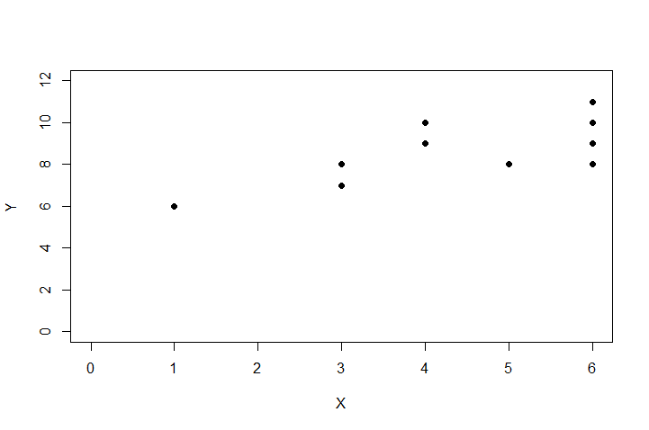
Scatter plot of X and Y from the 12 rolls

Slide 8
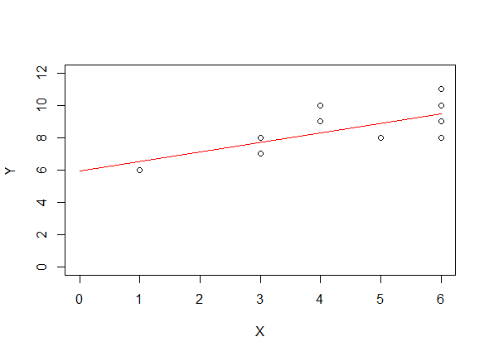
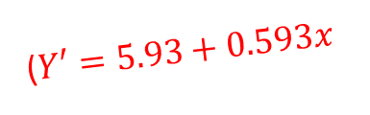
OLS coefficients: predicted values and errors
Identify:
What are the predicted values of Y?
Where are the prediction errors?
($Y′=5.93+0.593x$

Slide 9
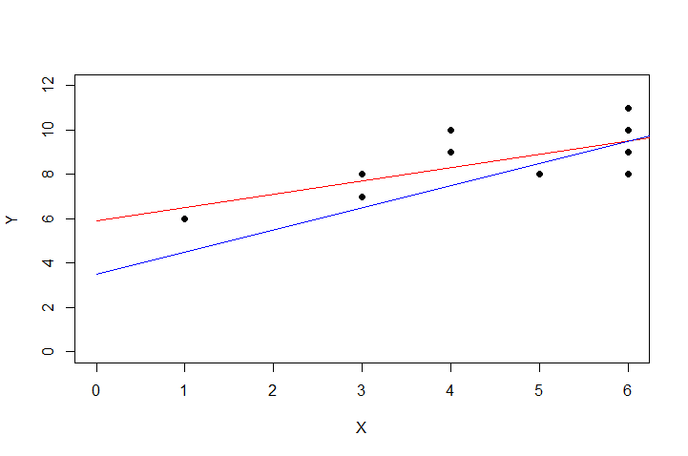
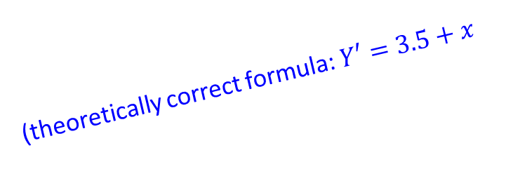
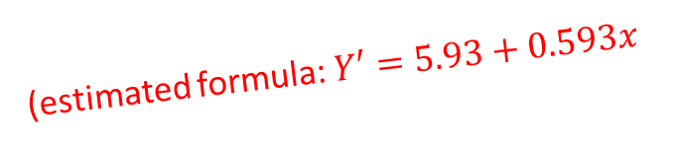
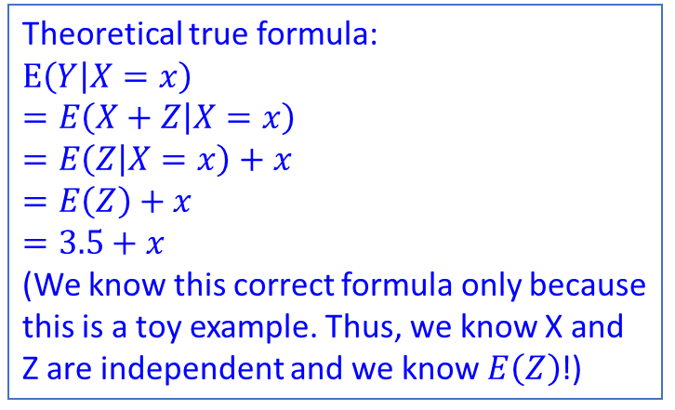
The coefficients are statistics
Theoretical true formula:
$E\left(Y | X=x\right)$
$=E\left(X+Z | X=x\right)$
$=E\left(Z | X=x\right)+x$
$=E\left(Z\right)+x$
$=3.5+x$
(We know this correct formula only because this is a toy example. Thus, we know X and Z are independent and we know $E\left(Z\right)$!)
(estimated formula: $Y′=5.93+0.593x$
(theoretically correct formula: $Y′=3.5+x$
Why the estimated line/formula is different from the true one?

Slide 10
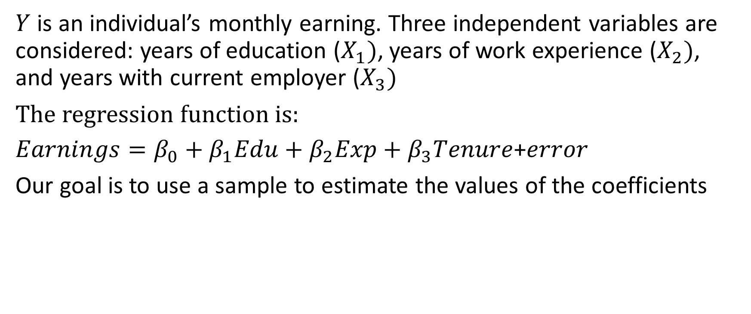

Interpretations of the coefficients $"β"$: monthly earnings
$Y$ is an individual’s monthly earning. Three independent variables are considered: years of education ($X_{1})$, years of work experience ($X_{2})$, and years with current employer ($X_{3})$
The regression function is:
$Earnings=β_{0}+β_{1}Edu+β_{2}Exp+β_{3}Tenure$+$error$
Our goal is to use a sample to estimate the values of the coefficients

Slide 11
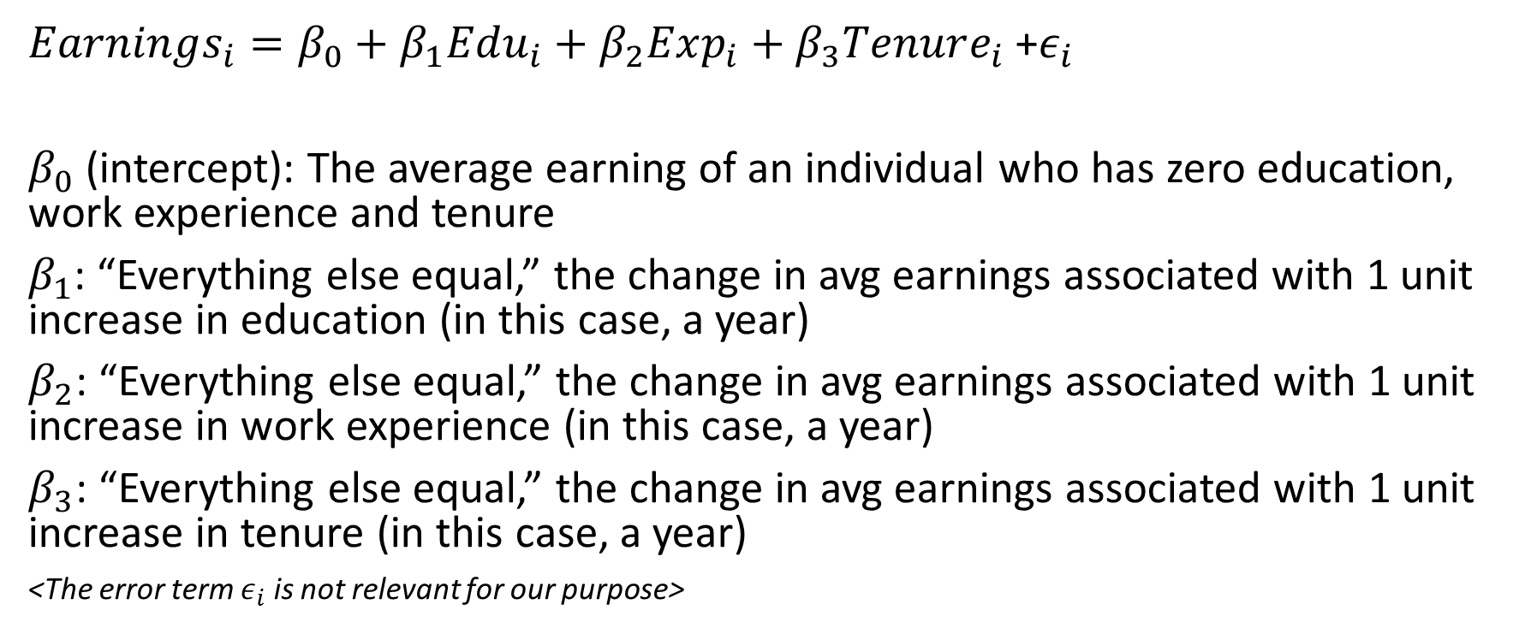

Interpretations of the coefficients $"β"$
$Earnings_{i}=β_{0}+β_{1}Edu_{i}+β_{2}Exp_{i}+β_{3}Tenure_{i}$ +$ε_{i}$
$β_{0}$ (intercept): The average earning of an individual who has zero education, work experience and tenure
$β_{1}$: “Everything else equal,” the change in avg earnings associated with 1 unit increase in education (in this case, a year)
$β_{2}$: “Everything else equal,” the change in avg earnings associated with 1 unit increase in work experience (in this case, a year)
$β_{3}$: “Everything else equal,” the change in avg earnings associated with 1 unit increase in tenure (in this case, a year)
<The error term $ε_{i}$ is not relevant for our purpose>

Slide 12
Linear regression in R
#install the package that has the dataset “wage2”
>install.packages(“wooldridge”)
>library(wooldridge)
>reg.results <-lm(wage ~ educ + exper +tenure, data= wage2)
>summary(reg.results)

Slide 13
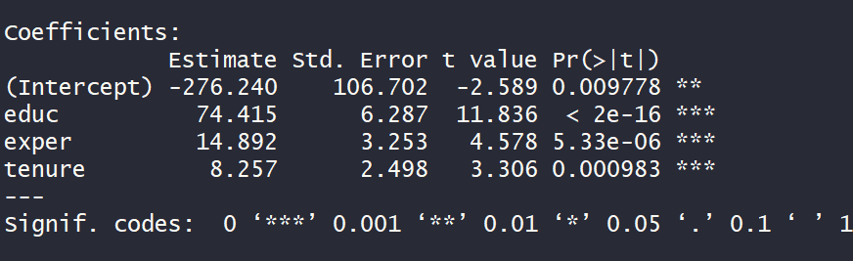
Interpreting the coefficients
Run the regression
Interpret the coefficient estimates: their values (practical significance) and hypothesis test results (statistical sig)
You may use the coefficients to predict Y based on X (if you wish)

